Slide 1



Fracture Liaison Service
Fracture Prevention Program
Business Case/
Quality Measure Slides
October 2015

Slide 2

Osteoporosis: Definition
Osteoporosis is a disease characterized by weakened and fragile bone tissue, leading to an increased chance of fracture
Normal
Osteoporosis

Slide 3
Fragility Fracture: Definition
  A fragility fracture (a fracture caused by osteoporosis or low bone mass) is any fall from a standing height or less that results in a fracture
  we should be able to sustain a fall from standing height without fracturing unless there is an underlying cause that makes the bones fragile
  A fragility fracture suffered by a man or woman age 50 or above is a sign of an underlying disease: osteoporosis

Slide 4

The Impact of Osteoporosis and Bone Breaks in the United States
“Cast Mountain” represents just 1 DAY of fractures caused by osteoporosis in the U.S.

Slide 5

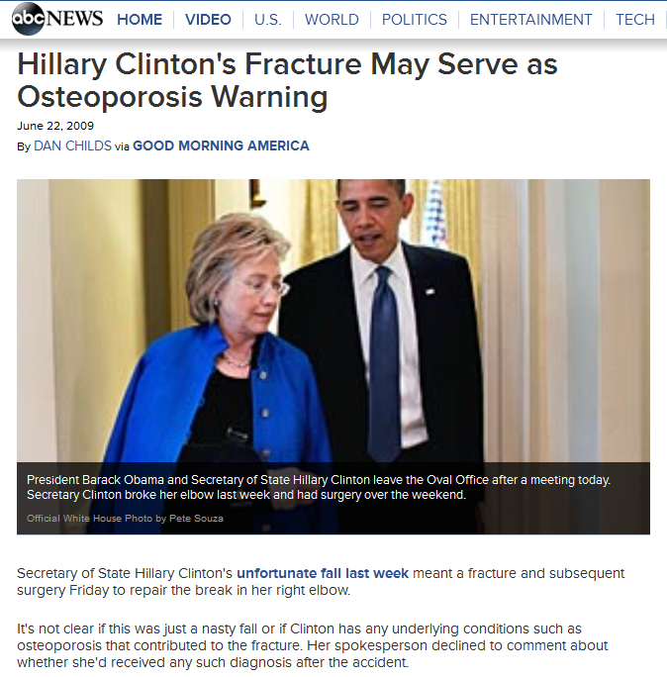
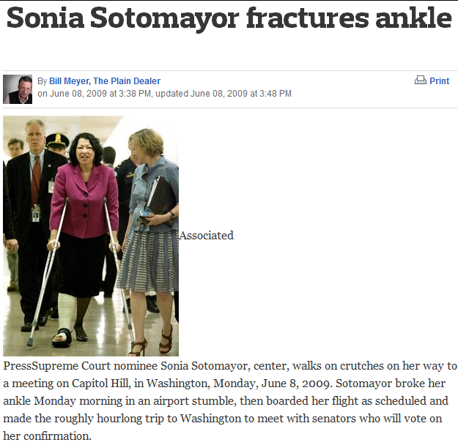
“…breaking a bone in his neck in a fall”
“…fell down on her way to the White House”
“…in an airport stumble”

Slide 6
Prevalence of Osteoporosis and Low Bone Mass
Americans Age 50 and Above Affected
by Osteoporosis/Low Bone Mass, 2010 to 2030 (projected)
54 million of 99 million Americans age 50+ (2010)
17% of the ENTIRE U.S. POPULATION (2010)
+27% change from 2010 to 2030
Millions
Wright, NC, et al. The Recent Prevalence of Osteoporosis and Low Bone Mass in the United States Based on Bone Mineral Density at the Femoral Neck or Lumbar Spine.
Journal of Bone and Mineral Research, November 2014; 29(11): 2520-2526.

Slide 7
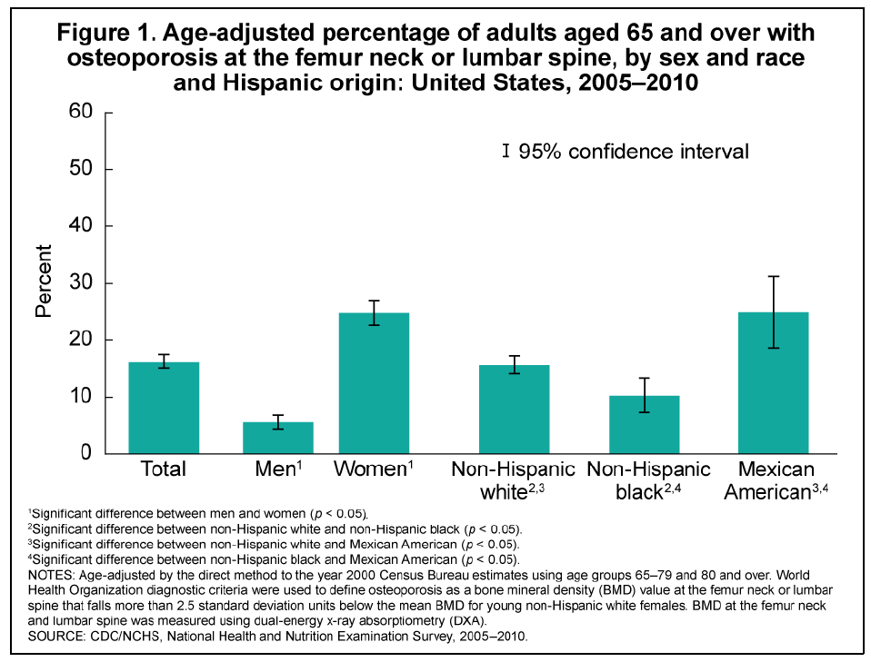
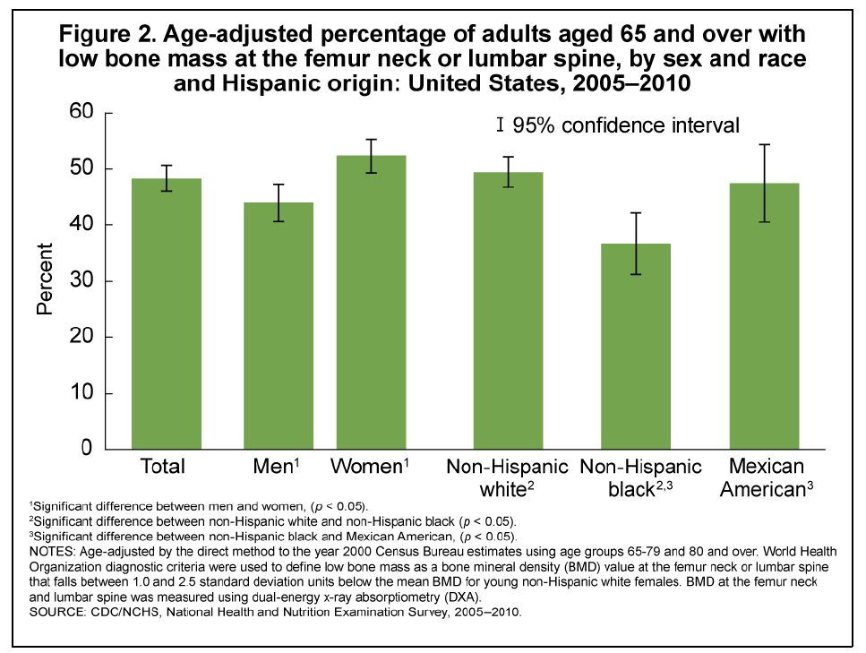
Prevalence of Osteoporosis and Low Bone Mass
NEW 2005-2010 CDC DATA: Americans Age 65+ Affected by
Osteoporosis (16.2%) and Low Bone Mass (48.3%)
64.5% of 65+ population at increased fracture risk
Looker AC and Frenk SM. Percentage of Adults Aged 65 and Over With Osteoporosis or Low Bone Mass at the Femur Neck or Lumbar Spine: United States, 2005–2010. CDC Division of Health and Nutrition Examination Surveys, August 2015.

Slide 8
Economic Impact of Osteoporosis and Bone Breaks
Medicare spent more than $5 billion to treat fractures among seniors [1999]
Of over 30 million elderly Medicare recipients [2002]:
  1.6 million (5%) were treated for a fracture
    80% of the total osteoporotic fractures that occur each year
  An additional 7.2 million (24%) had osteoporosis but had not yet fractured
Projected to 2008 dollars, the national cost of osteoporosis and fractures in the Medicare population was $22 billion
  This figure is projected to grow to over $25 billion per year by 2025
Osteoporosis was the 10th most costly major illness among the top 5% highest cost Medicare beneficiaries (12% of all beneficiaries and 18% of high costs beneficiaries) [2010]

Slide 9
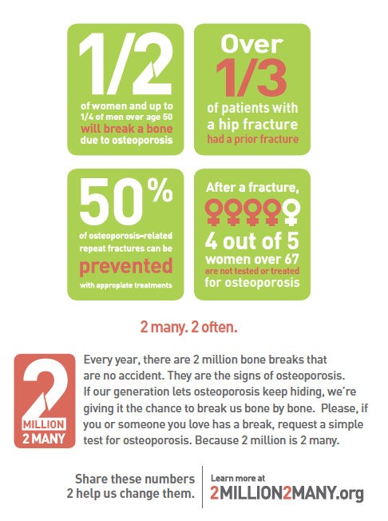
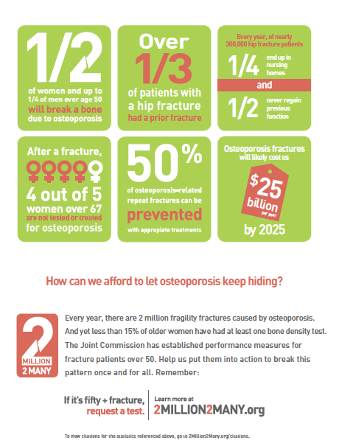
Human and Financial Impact of
Osteoporosis and Bone Breaks
70% CARE GAP

Slide 10
Osteoporosis and Fracture-Related
Quality Measures

Slide 11
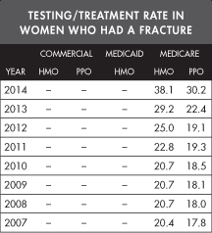
NCQA HEDIS Osteoporosis Quality Measures (1)
Osteoporosis management in women who had a fracture
(1 of 53 Medicare Advantage Five Star measures)
Assesses whether women age 65-85 who suffered a fracture and who had, within 6 months of the fracture:
  a bone mineral density test or
  A prescription for a drug to treat osteoporosis
Secondary fracture prevention measure
2014 health plan measure performance*
(~70% care gap):
  30.2% (Medicare PPOs)
  38.1% (Medicare HMOs)
www.ncqa.org/ReportCards/HealthPlans/StateofHealthCareQuality/2015TableofContents/Osteoporosis.aspx

Slide 12
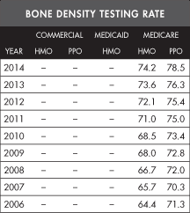
NCQA HEDIS Osteoporosis Quality Measures (2)
Osteoporosis testing in older women
A survey-based measure that assesses the percentage of women age 65-85 who report ever having received a bone density test to check for osteoporosis
Primary fracture prevention measure
2014 health plan measure adherence*:
  78.5% (Medicare PPOs)
  74.2% (Medicare HMOs)
www.ncqa.org/ReportCards/HealthPlans/StateofHealthCareQuality/2015TableofContents/Osteoporosis.aspx

Slide 13
Osteoporosis Care Lags FAR BEHIND Other Major Diseases/Conditions (2013 HEDIS HMO data)
National Committee on Quality Assurance, “The State of Health Care Quality 2014”. 2014.

Slide 14
CMS Physician Quality Reporting System (PQRS) Osteoporosis Quality Measures
Osteoporosis: Communication with the Physician Managing Ongoing Care Post-Fracture of Hip, Spine or Distal Radius for Men and Women Aged 50 Years and Older (measure #24)
Screening or Therapy for Osteoporosis for Women Aged 65 Years and Older (measure #39)
Osteoporosis: Management Following Fracture of Hip, Spine or Distal Radius for Men and Women Aged 50 Years and Older (measure #40)
Osteoporosis: Pharmacologic Therapy for Men and Women Aged 50 Years and Older (measure #41)
Falls: Risk Assessment (measure #154)
Falls: Plan of Care (measure #155)

Slide 15
Solution to the
Osteoporosis Care and Treatment Gap?
FRACTURE LIAISION SERVICE (FLS) MODEL OF CARE

Slide 16
Fracture Liaison Service Model of Care:
Reducing the Rate of Secondary Fractures
Those that fracture are usually not treated with calcium, vitamin D or a prescription medication
  little attention paid to preventing future falls
This lack of commitment to fracture prevention is a major failing of the U.S. health care system and leads to increased health care expenditures, morbidity and mortality
Health systems abroad and select programs in the U.S. have created programs that identify patients after a fracture and ensure appropriate management through a fracture liaison service (FLS)
  these programs have all accomplished a reduction in secondary fractures as well as health care cost savings

Slide 17
Fracture Liaison Service (FLS) Model of Care (2)
A coordinated preventive care model which operates under the supervision of bone health specialists and collaborates with the patient’s primary care physician
  Coordinates post-fracture care through a FLS coordinator (a RN, NP, PA or other health care professional) who ensures individuals who fracture receive appropriate diagnosis, treatment and support
  Patients with recent fractures are tracked via a population registry
  Processes and timelines established for patient assessment and follow-up
FLS programs have been successful in a number of closed and open settings, both in the U.S. and abroad (most notably in the U.K. and Canada)
These programs have greatly reduced the number of costly and serious recurrent fractures by identifying and appropriately treating post-fracture patients, recognizing that this group has the highest risk of future fractures

Slide 18
Why Secondary Fracture Prevention?
Maximize cost-effectiveness by stepwise delivery
Objective 1: Improve outcomes and efficiency of care after hip fractures by delivering professional standards per established performance and quality measures
Hip fracture patients
Objective 2: Respond to the first fracture to prevent the second through establishment of Fracture Liaison Services bridging hospital and primary care services for fracture patients
Non-hip fragility fracture patients
Individuals at high risk of first fragility fracture or other injurious falls
Objective 3: Health insurers or primary care providers to stratify risk for their patients using fracture risk assessment tools combined with bone density testing
Objective 4: Consistent delivery of public health messages on preserving physical activity, healthy lifestyles and reducing environmental hazards
Older people
(Adapted from Falls and fractures: Effective interventions in health and social care)

Slide 19
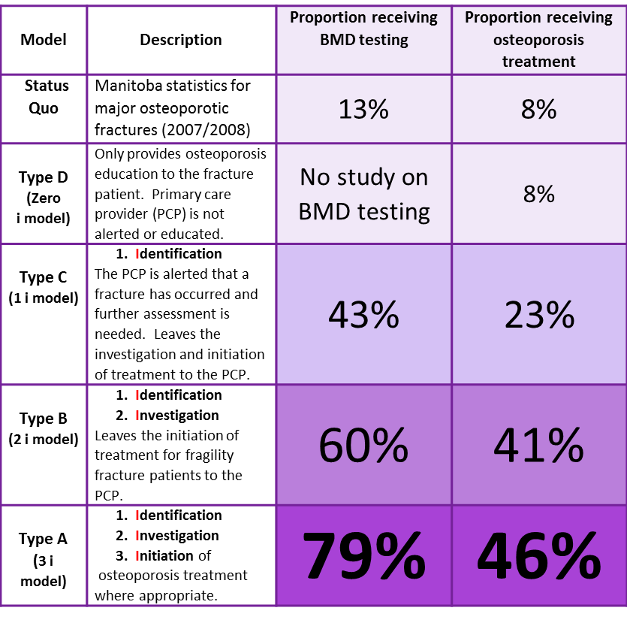
FLS Effectiveness:
Dependent on its Intensity
1. Ganda K et al. Osteoporosis International 2013 Feb; 24(2): 393-406.
2. Osteoporosis Canada. “Make the FIRST break the LAST with Fracture Liaison Services”.

Slide 20
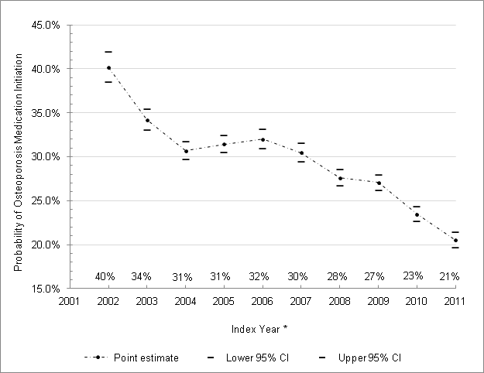
Annual Unadjusted Probability of Osteoporosis Medication Use Within 12 Months After Discharge*
* Solomon, et al., “Osteoporosis Medication Use after Hip Fracture in U.S. Patients between 2001 and 2011.” JBMR (September 2014);29(9): 1929-37.

Slide 21
Treatment After Hip Fracture in the UK:
Effect of FLS

Slide 22
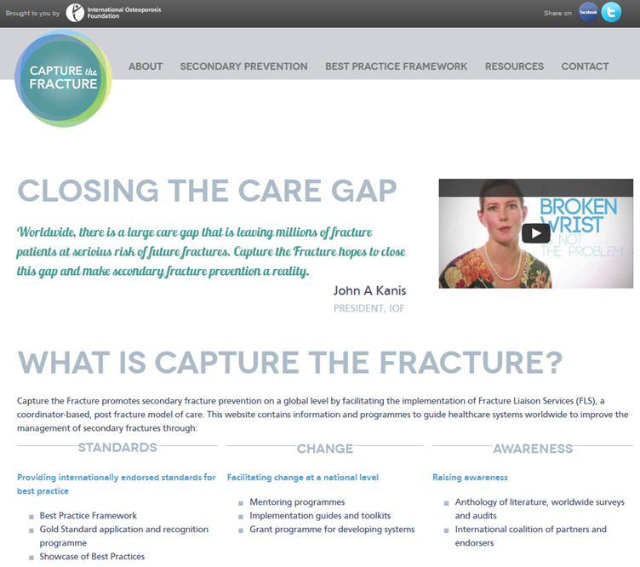
INTERNATIONAL CONSENSUS:
FLS Model of Care – Solution to the Care Gap
ASBMR Task Force Report on Secondary Fracture Prevention: Making the First Fracture the Last Fracture (July 2012)
Fragility Fracture Network
International Geriatric Fracture Society
IOF Capture the Fracture initiative (April 2013)
Defines “best practice framework”
  13 elements of a successful FLS program
NBHA Fracture Prevention CENTRAL included as US “toolkit”
Osteoporosis Canada FLS toolkit (October 2013)
UK Fracture Liaison Service toolkit (2010)

Slide 23
United States FLS Outcomes (1)
Solomon, Patrick, Schousboe, and Losina (2014) assessed the cost-effectiveness of FLS programs (targeted to men and women who experienced a hip fracture) from a healthcare system perspective:
for every 10,000 post-fracture patients, an FLS program would result in:
153 fewer fractures (109 hip, 5 wrist, 21 spine, 17 other)
37.4 more quality-adjusted life years (QALY)
$66,879 in cost savings compared with typical post-fracture care
The authors:
concluded that FLS programs targeting patients post-hip fracture should result in cost-savings and reduced fractures under most scenarios
estimated that, if all post-fracture patients in the U.S. were cared for in a FLS, total cost savings might be as much as $16.7 million
    * Solomon DH, Patrick AR, Schousboe J, Losina E. “The Potential Economic Benefits of Improved Post-Fracture Care: A Cost-Effectiveness Analysis of a Fracture Liaison Service in the US Health Care System” Journal of Bone and Mineral Research 1/20/2014.

Slide 24
United States FLS Outcomes (2)
1. Kaiser Permanente
Reduced the hip fracture rate expected by over 40% (since 1998)
If implemented nationally, a similar effort could reduce the number of hip fractures by over 100,000 (and save over $5 billion/year)
2. Geisinger Health System
Achieved $7.8 million
in cost savings from 1996-2000
3. American Orthopaedic Association
Own the Bone® Program
Achieved statistically significant changes in health professional behavior/referral (calcium and vitamin D, exercise, fall prevention, etc.)
Over 190 sites and 25,000+ patients involved from 48 states (since June 2009)

Slide 25
International FLS Outcomes
1. Canada (University of Alberta, Edmonton)
For every 100 patients, 3 fractures (1 hip fracture) prevented
Health care savings: $27,000/patient over their remaining lifetime
2. United Kingdom (Department of Health, National Health Service)
£291,000 saved in acute/community services and social care costs against £234,000 in spending
At a national level: savings of £8.5 million over 5 years
3. Scotland (Glasgow Fracture Liaison Service)
For every 1,000 fracture patients, 18 fewer fractures (11 hip fractures/7 other fractures) = overall savings of £26,000
122 hip/81 other fractures avoided

Slide 26
Reasons for the Lack of Broad U.S. Implementation of the FLS Model of Care
Lack of awareness among health care professionals that patients who fracture are of highest risk for future fractures
  50% of all patients who fracture a hip have already suffered a fracture
Lack of awareness about the successful FLS model of care itself, particularly among primary care practitioners and hospital administrators
Lack of knowledge by health care administrators and health care professionals (as well as potential sites) about this model of care and how it can be implemented
Lack of tools to help interested sites, health care professional champions, and health care administrators implement the FLS model of care
There are currently 250-300 active FLS programs in the U.S. – we estimate we will need 1,000 active programs by 2020 to achieve NBHA’s 20/20 vision
~700 NEW PROGRAMS NEEDED IN THE NEXT 5 YEARS

Slide 27
FLS/Quality Measure Tools
Tools and resources developed by NBHA to help sites set up and implement FLS programs and drive osteoporosis/post-fracture clinical quality improvement:
Fracture Prevention CENTRAL (March 2013): fracture prevention program resource center that has attracted over 2,900 registrants since its launch
FLS Demonstration Project (December 2013): provides a “turnkey” way to set up a FLS, drive improvement in performance around quality measures, and improve care coordination – piloting use of these tools in 3 clinical sites
CMS-approved Qualified Clinical Data Registry (September 2014): provides ability for HCPs to report on osteoporosis quality measures (2014 and 2015)
  First major financial “stick” was implemented last year:
    non-participation will lead not only to no 0.5% bonus payment but also
    reduction in ALL Medicare reimbursements by 1-3% in 2015/2016
  Penalties higher in 2015

Slide 28
Fracture Prevention CENTRAL, an Online FLS Resource: this publicly-accessible website was launched in March 2013 (available at www.FracturePreventionCENTRAL.org) to help HCPs and administrators implement a coordinator-based, post-fracture FLS model of care to reduce secondary fractures and the associated costs while increasing patient outcomes:
NBHA compiled materials from a number of successful domestic and international post-fracture care programs
  highlights the work of leading FLS programs including the American Orthopaedic Association Own the Bone program, Kaiser Permanente and Geisinger Health System
Fracture Prevention CENTRAL enables sites to implement a FLS in support of NBHA’s 20/20 vision to reduce fractures 20% by the year 2020

Slide 29
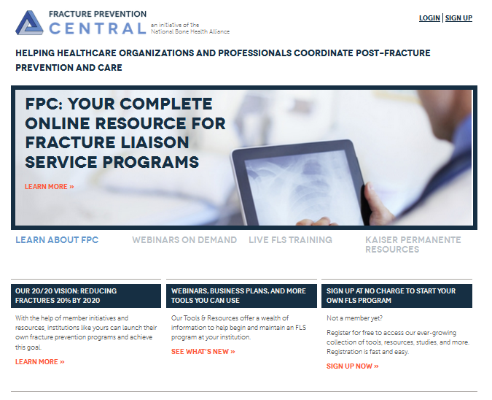
www.FracturePreventionCENTRAL.org
More than 2,900 individual users have signed up to access
these tools
since March 2013

Slide 30
Webinar Series: Fracture Prevention CENTRAL has hosted 12 webinars to date that allow participants to interact with experts around the FLS model of care:
An Introduction to Fracture Prevention CENTRAL/the Fracture Liaison Service Model of Post-Fracture Care Coordination
Implementing a Secondary Fracture Prevention Program: Where to Start Depends on Where You Sit
Making the Case: Convincing Administration to Support Your Fracture Prevention Program
FLS Implementation in an Orthopaedic Practice Setting
FLS Implementation in a Rheumatology/Endocrinology Practice Setting
Fracture Prevention CENTRAL Looks to 2014/FLS Implementation in a Primary Care Setting
Setting Up Your Fracture Liaison Service Program for Success: Steps, Materials, FAQs and Guidelines You Want and Need
Health Care Quality 101: What, Why and How
How Transitioning to ICD-10 Coding Will Impact Your Osteoporosis Practice
NBHA/NOF Qualified Clinical Data Registry: Maximize Reimbursement and Results (2 webinars)
Launch of NBHA’s One-on-One FLS Consult Service
All of these webinars are available for on-demand access (www.nbha.org/fpc/educational-webinars or www.youtube.com/channel/UC7ou3V8s3lauVYTwJOeWvng)

Slide 31
2015 Activities:
1-on-1 Peer Implementation Assistance: Beginning in July, Fracture Prevention CENTRAL began offering the ability for sites needing implementation support to receive direct 1-on-1 technical assistance from FLS experts at no charge (via teleconference or web conference)
  face-to-face opportunities also offered during the National Osteoporosis Foundation and American Society for Bone and Mineral Research annual meetings
FLS Return on Investment calculator: NBHA is working with the Research Triangle Institute and University of Alabama/Birmingham to develop a model that will allow sites to enter their historical fracture volume and clinical data to make the FLS business case both in the present as well as looking into the future
Exhibits, posters and presentations at national meetings: Fracture Prevention CENTRAL has a presence, through oral and poster presentations and exhibits, at national and international (i.e., ISCD, AACE, IOF, NOF, FFN and ASBMR)
New YouTube channel: direct access to on demand webinars
  https://www.youtube.com/channel/UC7ou3V8s3lauVYTwJOeWvng

Slide 32

Bone Health Collaborative
Fracture Liaison Service Care Coordination Demonstration Project
A Collaboration Among:
CECity, Inc.
National Bone Health Alliance
National Osteoporosis Foundation
Funding provided by Merck and Co., Inc.

Slide 33


Fracture Liaison Service Demonstration Project
In December 2013, NBHA, NOF and CECity embarked on a 15 month demonstration project (funded by Merck and Co., Inc.) which would demonstrate (initially in 3 clinical sites) the effectiveness of a combination of:
implementation of the proven FLS model of care with
a “turnkey” FLS solution (using CECity’s cloud-based MedConcert® platform and care coordination tools, www.medconcert.com)
  create a means for sites to automate, benchmark and improve their performance around selected osteoporosis/post-fracture quality measures and patient care
The three selected demonstration sites:
Alegent Creighton Health, Omaha, NE [site lead: Robert Recker, MD]
Medstar Georgetown University Hospital, Washington, DC [site lead: Andrea Singer, MD]
UPMC, Pittsburgh, PA [site lead: Susan Greenspan, MD]

Slide 34
FLS Demonstration Project (2)
The FLS application on CECity’s MedConcert platform has enabled demonstration sites, site leaders, FLS coordinators and other members of the care team to:
automate data collection more efficiently into a centralized registry
track in real time data and benchmark performance against a set of osteoporosis/post-fracture diagnosis, screening and treatment quality measures
enable and improve care coordination and care transitions across walls/institutions to the ambulatory setting
Provide clinical decision support and improvement tools that will prompt FLS coordinators and other members of the care team regarding the next step in the care for each patient based upon the proven FLS model
This demonstration study is assessing hospitals’ adoption and implementation of a FLS across their communities and measure improvement in performance around selected quality measures

Slide 35
MedConcert FLS Demonstration Project Tools
The suite of CECity’s MedConcert FLS tools include:
Patient registry
Patient task tracker (including reimbursement guidance)
Quality measure performance dashboard (which allows for real-time tracking of performance by site or in comparison with other sites and national averages)
Quality improvement tools, resources and interventions to drive performance change
Coordination of care application that allows all members of the care team, regardless of institution, to coordinate patient care and follow-up
These tools are available through
Ostonics Quality Solutions, LLC to additional sites/payers/systems

Slide 36


FLS Demonstration Project (3)
Data collection concluded in April 2015
  data analysis now complete/results will be published in 2016
Phase 2
  sites will continue to use the platform through the end of 2015
Launch of Ostonics Quality Solutions
  To encourage widespread adoption of these FLS, quality improvement and care coordination tools, NBHA helped incubate a joint venture, Ostonics Quality Solutions, LLC, which will sell these tools to interested sites, health systems and payers

Slide 37

FLS Demonstration Project featured in March 23, 2015 Wall Street Journal
“The National Bone Health Alliance…is nearing completion of a year-long pilot project at three hospitals to test programs called fracture-liaison services that make bone-density tests routine...”
“A key goal of the hospital pilot project…is to find out if a fracture-liaison service can be effective in a non-managed-care environment.”
Many experts believe fracture-liaison services will be more widely adopted once Medicare…pegs more of its payments to patients’ overall health outcomes.
www.wsj.com/articles/men-are-new-target-for-osteoporosis-treatment-1427125978

Slide 38
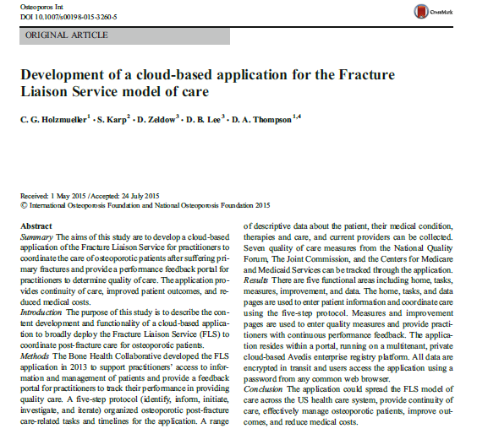
Osteoporosis International article – August 2015
“The National Bone Health Alliance…is nearing completion of a year-long pilot project at three hospitals to test programs called fracture-liaison services that make bone-density tests routine...”
http://link.springer.com/article/10.1007%2Fs00198-015-3260-5

Slide 39
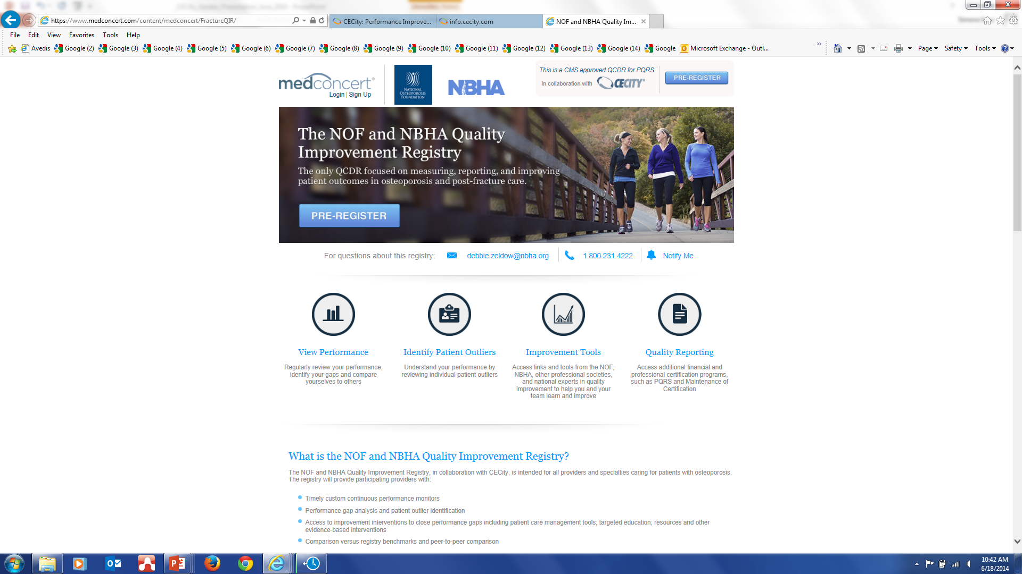
www.medconcert.com/FractureQIR/
CMS-approved NBHA, NOF and CECity osteoporosis Qualified Clinical Data Quality Improvement Registry (QCDR)

Slide 40
What is a Qualified Clinical Data Registry?
A Qualified Clinical Data Registry (QCDR) is a CMS-approved entity that:
collects medical and/or clinical data for the purpose of patient and disease tracking to foster improvement in the quality of care provided to patients
  the data submitted to CMS via a QCDR covers quality measures across multiple payers and is not limited to Medicare beneficiaries
a QCDR is different from a qualified registry in that it is not limited to measures within Physician Quality Reporting System (PQRS) quality measures
  a QCDR may submit up to 20 non-PQRS measures

Slide 41
What is a Qualified Clinical Data Registry? (2)
Allows Eligible Healthcare Professionals (EPs) to satisfy PQRS quality reporting requirements and will help EPs avoid losing revenue should they not participate in PQRS
  In 2014, based on 2012 average Medicare billing rates, this revenue at risk by bone health specialty (which is greater in the 2015 calendar year) was:
    $5,249 (endocrinology)
    $6,769 (orthopaedics)
    $16,751 (rheumatology)

Slide 42
2014 Osteoporosis Registry:
Approved as CMS Qualified Clinical Data Registry
In May 2014, CMS approved the NBHA/NOF osteoporosis quality improvement registry (powered by CECity) as a Qualified Clinical Data Registry (QCDR) for the 2014 Physician Quality Reporting System (PQRS) program year
Includes 6 PQRS and 8 non-PQRS measures
This QCDR designation has significant implications for all of us in osteoporosis and bone health, as evidenced by the recent statement by the Secretary of HHS of the goal to:
  tie 85% of all Medicare payments to quality or value by the end of 2016
  move the Medicare program toward paying providers based on quality, rather than the quantity, of care given patients

Slide 43
2015 Osteoporosis Registry:
Approved as CMS Qualified Clinical Data Registry
The 2015 osteoporosis QCDR has been approved by CMS
  38 quality measures (22 PQRS and 16 non-PQRS measures) are included
  There are a number of new measures in this year’s QCDR compared to last year, based on feedback from the bone health community and practice managers regarding quality measures they are already reporting on and utilizing
  The 2015 QCDR will be available in late 2015

Slide 44
Health Care Reform Helping to Drive
FLS Adoption and Implementation
U.S. healthcare reform (“Affordable Care Act”) is transforming the healthcare system from fee for service to paying for quality, outcomes and care coordination
Major Centers for Medicare & Medicaid Services (CMS) initiatives include:
Accountable Care Organizations
Patient-Centered Medical Home model
Bundled payment initiatives
Qualified Clinical Data Registries (QCDR)
Medicare Advantage “5 Star” program
meaningful use electronic medical record incentive program

Slide 45
FLS Supports the CMS Triple Aim
  Better care for patients (increase in screening and treatment rates)
  diagnosis, screening and treatment drives improved patient outcomes
  Better health for our communities (reductions in the incidence of secondary fractures)
  up to 50% of repeat fractures can be avoided
  Lower costs through improvement for our healthcare system
  every 100 patients in a FLS program, 1 hip fracture and 2-3 other fractures avoided
    a 500 patient FLS program would net ~$175,000-225,000 in healthcare cost savings (after taking into account FLS coordinator salary, bone density testing, and treatment costs)

Slide 46
Introduction to the FLS Post-Fracture Prevention Program / FLS Coordinator Position
A post-fracture prevention Fracture Liaison Service (FLS) program aims to ensure that post-fracture patients receive appropriate diagnosis, treatment and follow-up in order to bolster treatment adherence, reduce secondary fractures and create cost savings
FLS sites identify a FLS Coordinator responsible for ensuring continuity of care for post-fracture patients:
  Typically an allied health professional (NP/PA/RN), the FLS Coordinator identifies, communicates with and monitors post-fracture patients and ensures receipt of appropriate testing and treatment under the supervision of the patient’s primary care physician, orthopaedic surgeon, endocrinologist, rheumatologist or other responsible physician
  FLS Coordinators also work with hospital administrative staff to ensure the FLS meets certain treatment, prevention and outcome measures, as well as data collection requirements and standards
Individual FLS programs may vary from setting to setting, but are all based on the core process outlined on the next slide
  The model assumes that the FLS Coordinator is a NP or PA; to the extent that services are provided by a physician or nurse without a National Provider Identification (NPI) number, different protocols will apply and services may be billed as “incident to”

Slide 47
FLS Coordinator Reimbursement Model
Fracture patient admitted to ER or physician’s office
Hospital: EMR diagnosis and age trigger FLS Coordinator
Physician office: Office alerts FLS Coordinator
Upon identification, FLS Coordinator:
Meets with patient to review program, possible cost sharing
Collects patient medical history and enrolls patient through the FLS program website; an ID number is assigned to the patient
Begins patient tracking
FLS Coordinator services may be performed in person or over the phone.
If in person, report the appropriate CPT code(s) from the following range:
    99204, 99205, 99211-99215 (Office or outpatient)²
    99218-99226, 99231-99236 (Inpatient hospital)
    99238-99239 (Hospital discharge day management)
    99241-99245, 99251-99255 (Office and inpatient consultation)³
    99281-99285 (Emergency department)
    99304-99310, 99315-99316, 99318 (Nursing facility management)
    99324-99328, 99334-99337 (Long-term care facility E/M)
    99341-99345, 99347-99350 (Home visit E/M)
    99386, 99387, 99396, 99397, 99401-99404 (Prevention & risk factor reduction)³
    99495-99496 (Transitional care management)⁴
If by phone, report the appropriate CPT code(s) from the following range:
    99441-99443 (Telephone E/M service)³
    99487-99489 (Complex chronic care coordination)³
    99495-99496 (Transitional care management)⁴
    ** Appended appropriate modifiers as necessary. Providers should confirm with facility and payers that services are reimbursable; if services are not reimbursable, FLS Coordinator must inform patient of potential financial responsibility**
Patient admitted to hospital for surgery (e.g. hip fracture)
Osteoporosis / low bone mass confirmed by medical history
FLS coordinator¹ visit for osteoporosis assessment
Fracture patient
discharged to home or FAC facility
Patient treated for fracture and released (e.g., wrist fracture)
Osteoporosis / osteopenia not confirmed by medical history
≤4 weeks of discharge
≤8 weeks of discharge (and every 6 weeks until 6 months)
≤6 months of discharge
At 6 months and 1 year
If confirmed, assess patient’s treatment plan and adherence
If not confirmed, order tests and begin optimal treatment regimen as necessary
Obtain and interpret testing, determine appropriate management and initiate treatments in consultation with patient’s healthcare provider
Obtain appropriate laboratory testing (e.g., BMD test, blood and urine)
Ongoing patient assessment(i.e., re-evaluation, repeat BMD tests, chronic health visits)
Contact patient by phone to encourage medication adherence, answer questions and discuss fall prevention
At discharge, FLS Coordinator:
Determines patient’s post-fracture location (i.e., inpatient stay, home, other PAC facility) and performs a fracture prevention assessment
Identifies patient’s PCP or other appropriate chronic care professional to order post-fracture tests, medications and develops patient care plan
Distributes patient education material from FLS stakeholders and champions
¹ FLS Coordinator should be an allied health professional certified by CMS or other organization to be determined
² CPT codes 99213 and 99214 are typically used by specialists and may require 24 modifier (unrelated E/M service by same physician or qualified health professional during a postoperative period)
³ Not currently reimbursed by Medicare
⁴ Typically reported by PCPs
EMR: Electronic Medical Record
PAC: Post-Acute Care
PCP: Primary Care Physician
BMD: Bone Mineral Density
E/M: Evaluation and Management
Current Procedural Terminology (CPT®) is a registered trademark of the American Medical Association (AMA).

Slide 48
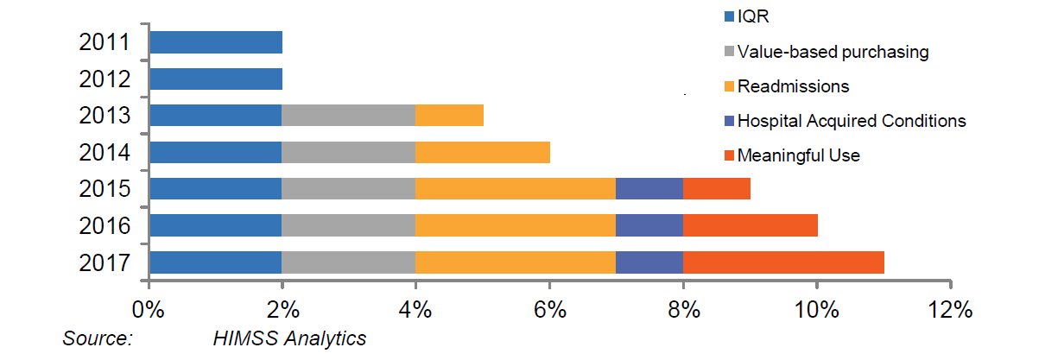
Impact of Health Reform:
Future Medicare Revenue at Risk
IQR: Inpatient Quality Reporting is data on conditions that are common to Medicare beneficiaries. It is reported by hospitals and is used by CMS to calculate payment rates.
Notes:
Inpatient Quality Reporting (IQR): The Hospital IQR program was originally mandated by Section 501(b) of the Medicare Prescription Drug, Improvement and Modernization Act (MMA) of 2003. This section of the MMA authorized CMS to pay hospitals that successfully report designated quality measures a higher annual update to their payment rates. Initially, the MMA provided a 0.4% reduction in the annual market basket update for hospitals that did not successfully report. The Deficit Reduction Act of 2005 increased that reduction to 2.0%. Additionally, this data is published online and Medicare patients can use it to choose which hospital to go to. Due to the high incidence of osteoporosis among Medicare patients, the FLS model is relevant to this measure. In addition, CMS also uses the IQR data to calculate payment rates under the Hospital Value-Based Purchasing (VBP) program.
Value-based Purchasing: The Hospital Value-based Purchasing Program began in FY 2013. Under the program, CMS makes value-based incentive payments to acute care hospitals, based either on how well the hospitals perform on certain quality measures or how much the hospitals' performance improves on certain quality measures from their performance during a baseline period. The higher a hospital's performance or improvement during the performance period for a fiscal year, the higher the hospital's value-based incentive payment for the fiscal year.
Readmissions: Beginning in fiscal year 2013 (October 1, 2012), the HRRP imposed a financial penalty on hospitals with excess Medicare readmissions. The HRRP applies to all general hospitals paid under the Medicare IPPS. The HRRP defines readmission as a Medicare patient who is readmitted to the same or another acute care hospital within 30 days of discharge. It excludes certain readmissions, such as transfers to another IPPS hospital, and readmissions classified by CMS as "planned," such as chemotherapy or rehabilitation. For the first two years (fiscal years 2013 and 2014), the HRRP applies to readmissions of Medicare patients ages 65 and older with diagnoses of acute myocardial infarction, heart failure, or pneumonia. The ACA gives the secretary of the Department of Health and Human Services the discretion to expand to additional high-volume or high-expenditure conditions to the extent practical. The Department of Health and Human Services has announced that the program will expand in October 2014 (fiscal year 2015) to include two additional conditions: elective hip or knee replacement and congestive obstructive pulmonary disease. Hospitals must have a minimum of 25 discharges for each applicable condition to be included for that condition. For purposes of the HRRP, excess readmissions are defined as those that exceed a hospital's "expected readmission rate.“
Hospital Acquired Conditions: Under the HAC Reduction Program, hospitals that rank in the lowest-performing quartile of hospital-acquired conditions will be paid 99 percent of what otherwise would have been paid under IPPS, beginning in FY 2015. The rule finalizes the quality measures and the scoring methodology to determine this quartile, as well as the process hospitals will use to review and correct their data. In the first year of the program, FY 2015, CMS will use measures that are part of the IQR program. The HAC measures will consist of two domains of measure sets. Domain 1 will include the Agency for Health Care Research and Quality (AHRQ) composite PSI #90. This measure includes the following indicators: Pressure ulcer rate (PSI 3); Iatrogenic pneumothorax rate (PSI 6); Central venous catheter-related blood stream infection rate (PSI 7); Postoperative hip fracture rate (PSI 8); Postoperative pulmonary embolism (PE) or deep vein thrombosis rate (DVT) (PSI 12); Postoperative sepsis rate (PSI 13); Wound dehiscence rate (PSI 14); and Accidental puncture and laceration rate (PSI 15). Domain 2 measures consist of two healthcare-associated infection measures developed by CDC’s National Health Safety Network: Central Line-Associated Blood Stream Infection and Catheter-Associated Urinary Tract Infection.
Meaningful Use: The Medicare and Medicaid EHR Incentive Programs provide financial incentives for the “meaningful use” of certified EHR technology to improve patient care. To receive an EHR incentive payment, providers have to show that they are “meaningfully using” their EHRs by meeting thresholds for a number of objectives. CMS has established the objectives for “meaningful use” that eligible professionals, eligible hospitals, and critical access hospitals (CAHs) must meet in order to receive an incentive payment. The Medicare and Medicaid EHR Incentive Programs are staged in three stages with increasing requirements for participation. Eligible professionals participate in the program on the calendar years, while eligible hospitals and CAHs participate according to the federal fiscal year. Providers must attest to demonstrating meaningful use every year to receive an incentive and avoid a Medicare payment adjustment.

Slide 49
Impact of Health Reform:
Future Medicare Revenue at Risk
IQR: FLS is relevant to IQR and can help hospitals avoid a 2% decrease in the annual market basket update.
Notes:
Inpatient Quality Reporting (IQR): The Hospital IQR program was originally mandated by Section 501(b) of the Medicare Prescription Drug, Improvement and Modernization Act (MMA) of 2003. This section of the MMA authorized CMS to pay hospitals that successfully report designated quality measures a higher annual update to their payment rates. Initially, the MMA provided a 0.4% reduction in the annual market basket update for hospitals that did not successfully report. The Deficit Reduction Act of 2005 increased that reduction to 2.0%. Additionally, this data is published online and Medicare patients can use it to choose which hospital to go to. Due to the high incidence of osteoporosis among Medicare patients, the FLS model is relevant to this measure. In addition, CMS also uses the IQR data to calculate payment rates under the Hospital Value-Based Purchasing (VBP) program.
Value-based Purchasing: The Hospital Value-based Purchasing Program began in FY 2013. Under the program, CMS makes value-based incentive payments to acute care hospitals, based either on how well the hospitals perform on certain quality measures or how much the hospitals' performance improves on certain quality measures from their performance during a baseline period. The higher a hospital's performance or improvement during the performance period for a fiscal year, the higher the hospital's value-based incentive payment for the fiscal year.
Readmissions: Beginning in fiscal year 2013 (October 1, 2012), the HRRP imposed a financial penalty on hospitals with excess Medicare readmissions. The HRRP applies to all general hospitals paid under the Medicare IPPS. The HRRP defines readmission as a Medicare patient who is readmitted to the same or another acute care hospital within 30 days of discharge. It excludes certain readmissions, such as transfers to another IPPS hospital, and readmissions classified by CMS as "planned," such as chemotherapy or rehabilitation. For the first two years (fiscal years 2013 and 2014), the HRRP applies to readmissions of Medicare patients ages 65 and older with diagnoses of acute myocardial infarction, heart failure, or pneumonia. The ACA gives the secretary of the Department of Health and Human Services the discretion to expand to additional high-volume or high-expenditure conditions to the extent practical. The Department of Health and Human Services has announced that the program will expand in October 2014 (fiscal year 2015) to include two additional conditions: elective hip or knee replacement and congestive obstructive pulmonary disease. Hospitals must have a minimum of 25 discharges for each applicable condition to be included for that condition. For purposes of the HRRP, excess readmissions are defined as those that exceed a hospital's "expected readmission rate.“
Hospital Acquired Conditions: Under the HAC Reduction Program, hospitals that rank in the lowest-performing quartile of hospital-acquired conditions will be paid 99 percent of what otherwise would have been paid under IPPS, beginning in FY 2015. The rule finalizes the quality measures and the scoring methodology to determine this quartile, as well as the process hospitals will use to review and correct their data. In the first year of the program, FY 2015, CMS will use measures that are part of the IQR program. The HAC measures will consist of two domains of measure sets. Domain 1 will include the Agency for Health Care Research and Quality (AHRQ) composite PSI #90. This measure includes the following indicators: Pressure ulcer rate (PSI 3); Iatrogenic pneumothorax rate (PSI 6); Central venous catheter-related blood stream infection rate (PSI 7); Postoperative hip fracture rate (PSI 8); Postoperative pulmonary embolism (PE) or deep vein thrombosis rate (DVT) (PSI 12); Postoperative sepsis rate (PSI 13); Wound dehiscence rate (PSI 14); and Accidental puncture and laceration rate (PSI 15). Domain 2 measures consist of two healthcare-associated infection measures developed by CDC’s National Health Safety Network: Central Line-Associated Blood Stream Infection and Catheter-Associated Urinary Tract Infection.
Meaningful Use: The Medicare and Medicaid EHR Incentive Programs provide financial incentives for the “meaningful use” of certified EHR technology to improve patient care. To receive an EHR incentive payment, providers have to show that they are “meaningfully using” their EHRs by meeting thresholds for a number of objectives. CMS has established the objectives for “meaningful use” that eligible professionals, eligible hospitals, and critical access hospitals (CAHs) must meet in order to receive an incentive payment. The Medicare and Medicaid EHR Incentive Programs are staged in three stages with increasing requirements for participation. Eligible professionals participate in the program on the calendar years, while eligible hospitals and CAHs participate according to the federal fiscal year. Providers must attest to demonstrating meaningful use every year to receive an incentive and avoid a Medicare payment adjustment.

Slide 50
Impact of Health Reform:
Future Medicare Revenue at Risk
VBP: Value-Based Purchasing refers to incentive payments CMS makes to hospitals based on how well the hospital performs on certain quality measures.
Notes:
Inpatient Quality Reporting (IQR): The Hospital IQR program was originally mandated by Section 501(b) of the Medicare Prescription Drug, Improvement and Modernization Act (MMA) of 2003. This section of the MMA authorized CMS to pay hospitals that successfully report designated quality measures a higher annual update to their payment rates. Initially, the MMA provided a 0.4% reduction in the annual market basket update for hospitals that did not successfully report. The Deficit Reduction Act of 2005 increased that reduction to 2.0%. Additionally, this data is published online and Medicare patients can use it to choose which hospital to go to. Due to the high incidence of osteoporosis among Medicare patients, the FLS model is relevant to this measure. In addition, CMS also uses the IQR data to calculate payment rates under the Hospital Value-Based Purchasing (VBP) program.
Value-based Purchasing: The Hospital Value-based Purchasing Program began in FY 2013. Under the program, CMS makes value-based incentive payments to acute care hospitals, based either on how well the hospitals perform on certain quality measures or how much the hospitals' performance improves on certain quality measures from their performance during a baseline period. The higher a hospital's performance or improvement during the performance period for a fiscal year, the higher the hospital's value-based incentive payment for the fiscal year.
Readmissions: Beginning in fiscal year 2013 (October 1, 2012), the HRRP imposed a financial penalty on hospitals with excess Medicare readmissions. The HRRP applies to all general hospitals paid under the Medicare IPPS. The HRRP defines readmission as a Medicare patient who is readmitted to the same or another acute care hospital within 30 days of discharge. It excludes certain readmissions, such as transfers to another IPPS hospital, and readmissions classified by CMS as "planned," such as chemotherapy or rehabilitation. For the first two years (fiscal years 2013 and 2014), the HRRP applies to readmissions of Medicare patients ages 65 and older with diagnoses of acute myocardial infarction, heart failure, or pneumonia. The ACA gives the secretary of the Department of Health and Human Services the discretion to expand to additional high-volume or high-expenditure conditions to the extent practical. The Department of Health and Human Services has announced that the program will expand in October 2014 (fiscal year 2015) to include two additional conditions: elective hip or knee replacement and congestive obstructive pulmonary disease. Hospitals must have a minimum of 25 discharges for each applicable condition to be included for that condition. For purposes of the HRRP, excess readmissions are defined as those that exceed a hospital's "expected readmission rate.“
Hospital Acquired Conditions: Under the HAC Reduction Program, hospitals that rank in the lowest-performing quartile of hospital-acquired conditions will be paid 99 percent of what otherwise would have been paid under IPPS, beginning in FY 2015. The rule finalizes the quality measures and the scoring methodology to determine this quartile, as well as the process hospitals will use to review and correct their data. In the first year of the program, FY 2015, CMS will use measures that are part of the IQR program. The HAC measures will consist of two domains of measure sets. Domain 1 will include the Agency for Health Care Research and Quality (AHRQ) composite PSI #90. This measure includes the following indicators: Pressure ulcer rate (PSI 3); Iatrogenic pneumothorax rate (PSI 6); Central venous catheter-related blood stream infection rate (PSI 7); Postoperative hip fracture rate (PSI 8); Postoperative pulmonary embolism (PE) or deep vein thrombosis rate (DVT) (PSI 12); Postoperative sepsis rate (PSI 13); Wound dehiscence rate (PSI 14); and Accidental puncture and laceration rate (PSI 15). Domain 2 measures consist of two healthcare-associated infection measures developed by CDC’s National Health Safety Network: Central Line-Associated Blood Stream Infection and Catheter-Associated Urinary Tract Infection.
Meaningful Use: The Medicare and Medicaid EHR Incentive Programs provide financial incentives for the “meaningful use” of certified EHR technology to improve patient care. To receive an EHR incentive payment, providers have to show that they are “meaningfully using” their EHRs by meeting thresholds for a number of objectives. CMS has established the objectives for “meaningful use” that eligible professionals, eligible hospitals, and critical access hospitals (CAHs) must meet in order to receive an incentive payment. The Medicare and Medicaid EHR Incentive Programs are staged in three stages with increasing requirements for participation. Eligible professionals participate in the program on the calendar years, while eligible hospitals and CAHs participate according to the federal fiscal year. Providers must attest to demonstrating meaningful use every year to receive an incentive and avoid a Medicare payment adjustment.

Slide 51
Impact of Health Reform:
Future Medicare Revenue at Risk
VBP: can increase Medicare reimbursement by 2%. There are over 30 osteoporosis-related measures, including more than a dozen central to the FLS model.
Notes:
Inpatient Quality Reporting (IQR): The Hospital IQR program was originally mandated by Section 501(b) of the Medicare Prescription Drug, Improvement and Modernization Act (MMA) of 2003. This section of the MMA authorized CMS to pay hospitals that successfully report designated quality measures a higher annual update to their payment rates. Initially, the MMA provided a 0.4% reduction in the annual market basket update for hospitals that did not successfully report. The Deficit Reduction Act of 2005 increased that reduction to 2.0%. Additionally, this data is published online and Medicare patients can use it to choose which hospital to go to. Due to the high incidence of osteoporosis among Medicare patients, the FLS model is relevant to this measure. In addition, CMS also uses the IQR data to calculate payment rates under the Hospital Value-Based Purchasing (VBP) program.
Value-based Purchasing: The Hospital Value-based Purchasing Program began in FY 2013. Under the program, CMS makes value-based incentive payments to acute care hospitals, based either on how well the hospitals perform on certain quality measures or how much the hospitals' performance improves on certain quality measures from their performance during a baseline period. The higher a hospital's performance or improvement during the performance period for a fiscal year, the higher the hospital's value-based incentive payment for the fiscal year.
Readmissions: Beginning in fiscal year 2013 (October 1, 2012), the HRRP imposed a financial penalty on hospitals with excess Medicare readmissions. The HRRP applies to all general hospitals paid under the Medicare IPPS. The HRRP defines readmission as a Medicare patient who is readmitted to the same or another acute care hospital within 30 days of discharge. It excludes certain readmissions, such as transfers to another IPPS hospital, and readmissions classified by CMS as "planned," such as chemotherapy or rehabilitation. For the first two years (fiscal years 2013 and 2014), the HRRP applies to readmissions of Medicare patients ages 65 and older with diagnoses of acute myocardial infarction, heart failure, or pneumonia. The ACA gives the secretary of the Department of Health and Human Services the discretion to expand to additional high-volume or high-expenditure conditions to the extent practical. The Department of Health and Human Services has announced that the program will expand in October 2014 (fiscal year 2015) to include two additional conditions: elective hip or knee replacement and congestive obstructive pulmonary disease. Hospitals must have a minimum of 25 discharges for each applicable condition to be included for that condition. For purposes of the HRRP, excess readmissions are defined as those that exceed a hospital's "expected readmission rate.“
Hospital Acquired Conditions: Under the HAC Reduction Program, hospitals that rank in the lowest-performing quartile of hospital-acquired conditions will be paid 99 percent of what otherwise would have been paid under IPPS, beginning in FY 2015. The rule finalizes the quality measures and the scoring methodology to determine this quartile, as well as the process hospitals will use to review and correct their data. In the first year of the program, FY 2015, CMS will use measures that are part of the IQR program. The HAC measures will consist of two domains of measure sets. Domain 1 will include the Agency for Health Care Research and Quality (AHRQ) composite PSI #90. This measure includes the following indicators: Pressure ulcer rate (PSI 3); Iatrogenic pneumothorax rate (PSI 6); Central venous catheter-related blood stream infection rate (PSI 7); Postoperative hip fracture rate (PSI 8); Postoperative pulmonary embolism (PE) or deep vein thrombosis rate (DVT) (PSI 12); Postoperative sepsis rate (PSI 13); Wound dehiscence rate (PSI 14); and Accidental puncture and laceration rate (PSI 15). Domain 2 measures consist of two healthcare-associated infection measures developed by CDC’s National Health Safety Network: Central Line-Associated Blood Stream Infection and Catheter-Associated Urinary Tract Infection.
Meaningful Use: The Medicare and Medicaid EHR Incentive Programs provide financial incentives for the “meaningful use” of certified EHR technology to improve patient care. To receive an EHR incentive payment, providers have to show that they are “meaningfully using” their EHRs by meeting thresholds for a number of objectives. CMS has established the objectives for “meaningful use” that eligible professionals, eligible hospitals, and critical access hospitals (CAHs) must meet in order to receive an incentive payment. The Medicare and Medicaid EHR Incentive Programs are staged in three stages with increasing requirements for participation. Eligible professionals participate in the program on the calendar years, while eligible hospitals and CAHs participate according to the federal fiscal year. Providers must attest to demonstrating meaningful use every year to receive an incentive and avoid a Medicare payment adjustment.

Slide 52
Impact of Health Reform:
Future Medicare Revenue at Risk
Readmissions: The Hospital Readmissions Reduction Program requires CMS to reduce payments to IPPS hospitals with excessive readmissions.
Notes:
Inpatient Quality Reporting (IQR): The Hospital IQR program was originally mandated by Section 501(b) of the Medicare Prescription Drug, Improvement and Modernization Act (MMA) of 2003. This section of the MMA authorized CMS to pay hospitals that successfully report designated quality measures a higher annual update to their payment rates. Initially, the MMA provided a 0.4% reduction in the annual market basket update for hospitals that did not successfully report. The Deficit Reduction Act of 2005 increased that reduction to 2.0%. Additionally, this data is published online and Medicare patients can use it to choose which hospital to go to. Due to the high incidence of osteoporosis among Medicare patients, the FLS model is relevant to this measure. In addition, CMS also uses the IQR data to calculate payment rates under the Hospital Value-Based Purchasing (VBP) program.
Value-based Purchasing: The Hospital Value-based Purchasing Program began in FY 2013. Under the program, CMS makes value-based incentive payments to acute care hospitals, based either on how well the hospitals perform on certain quality measures or how much the hospitals' performance improves on certain quality measures from their performance during a baseline period. The higher a hospital's performance or improvement during the performance period for a fiscal year, the higher the hospital's value-based incentive payment for the fiscal year.
Readmissions: Beginning in fiscal year 2013 (October 1, 2012), the HRRP imposed a financial penalty on hospitals with excess Medicare readmissions. The HRRP applies to all general hospitals paid under the Medicare IPPS. The HRRP defines readmission as a Medicare patient who is readmitted to the same or another acute care hospital within 30 days of discharge. It excludes certain readmissions, such as transfers to another IPPS hospital, and readmissions classified by CMS as "planned," such as chemotherapy or rehabilitation. For the first two years (fiscal years 2013 and 2014), the HRRP applies to readmissions of Medicare patients ages 65 and older with diagnoses of acute myocardial infarction, heart failure, or pneumonia. The ACA gives the secretary of the Department of Health and Human Services the discretion to expand to additional high-volume or high-expenditure conditions to the extent practical. The Department of Health and Human Services has announced that the program will expand in October 2014 (fiscal year 2015) to include two additional conditions: elective hip or knee replacement and congestive obstructive pulmonary disease. Hospitals must have a minimum of 25 discharges for each applicable condition to be included for that condition. For purposes of the HRRP, excess readmissions are defined as those that exceed a hospital's "expected readmission rate.“
Hospital Acquired Conditions: Under the HAC Reduction Program, hospitals that rank in the lowest-performing quartile of hospital-acquired conditions will be paid 99 percent of what otherwise would have been paid under IPPS, beginning in FY 2015. The rule finalizes the quality measures and the scoring methodology to determine this quartile, as well as the process hospitals will use to review and correct their data. In the first year of the program, FY 2015, CMS will use measures that are part of the IQR program. The HAC measures will consist of two domains of measure sets. Domain 1 will include the Agency for Health Care Research and Quality (AHRQ) composite PSI #90. This measure includes the following indicators: Pressure ulcer rate (PSI 3); Iatrogenic pneumothorax rate (PSI 6); Central venous catheter-related blood stream infection rate (PSI 7); Postoperative hip fracture rate (PSI 8); Postoperative pulmonary embolism (PE) or deep vein thrombosis rate (DVT) (PSI 12); Postoperative sepsis rate (PSI 13); Wound dehiscence rate (PSI 14); and Accidental puncture and laceration rate (PSI 15). Domain 2 measures consist of two healthcare-associated infection measures developed by CDC’s National Health Safety Network: Central Line-Associated Blood Stream Infection and Catheter-Associated Urinary Tract Infection.
Meaningful Use: The Medicare and Medicaid EHR Incentive Programs provide financial incentives for the “meaningful use” of certified EHR technology to improve patient care. To receive an EHR incentive payment, providers have to show that they are “meaningfully using” their EHRs by meeting thresholds for a number of objectives. CMS has established the objectives for “meaningful use” that eligible professionals, eligible hospitals, and critical access hospitals (CAHs) must meet in order to receive an incentive payment. The Medicare and Medicaid EHR Incentive Programs are staged in three stages with increasing requirements for participation. Eligible professionals participate in the program on the calendar years, while eligible hospitals and CAHs participate according to the federal fiscal year. Providers must attest to demonstrating meaningful use every year to receive an incentive and avoid a Medicare payment adjustment.

Slide 53
Impact of Health Reform:
Future Medicare Revenue at Risk
Readmissions:Hip fractures account for 14.5% of 30-day readmissions. Fragility fractures being considered for future measured conditions.
Notes:
Inpatient Quality Reporting (IQR): The Hospital IQR program was originally mandated by Section 501(b) of the Medicare Prescription Drug, Improvement and Modernization Act (MMA) of 2003. This section of the MMA authorized CMS to pay hospitals that successfully report designated quality measures a higher annual update to their payment rates. Initially, the MMA provided a 0.4% reduction in the annual market basket update for hospitals that did not successfully report. The Deficit Reduction Act of 2005 increased that reduction to 2.0%. Additionally, this data is published online and Medicare patients can use it to choose which hospital to go to. Due to the high incidence of osteoporosis among Medicare patients, the FLS model is relevant to this measure. In addition, CMS also uses the IQR data to calculate payment rates under the Hospital Value-Based Purchasing (VBP) program.
Value-based Purchasing: The Hospital Value-based Purchasing Program began in FY 2013. Under the program, CMS makes value-based incentive payments to acute care hospitals, based either on how well the hospitals perform on certain quality measures or how much the hospitals' performance improves on certain quality measures from their performance during a baseline period. The higher a hospital's performance or improvement during the performance period for a fiscal year, the higher the hospital's value-based incentive payment for the fiscal year.
Readmissions: Beginning in fiscal year 2013 (October 1, 2012), the HRRP imposed a financial penalty on hospitals with excess Medicare readmissions. The HRRP applies to all general hospitals paid under the Medicare IPPS. The HRRP defines readmission as a Medicare patient who is readmitted to the same or another acute care hospital within 30 days of discharge. It excludes certain readmissions, such as transfers to another IPPS hospital, and readmissions classified by CMS as "planned," such as chemotherapy or rehabilitation. For the first two years (fiscal years 2013 and 2014), the HRRP applies to readmissions of Medicare patients ages 65 and older with diagnoses of acute myocardial infarction, heart failure, or pneumonia. The ACA gives the secretary of the Department of Health and Human Services the discretion to expand to additional high-volume or high-expenditure conditions to the extent practical. The Department of Health and Human Services has announced that the program will expand in October 2014 (fiscal year 2015) to include two additional conditions: elective hip or knee replacement and congestive obstructive pulmonary disease. Hospitals must have a minimum of 25 discharges for each applicable condition to be included for that condition. For purposes of the HRRP, excess readmissions are defined as those that exceed a hospital's "expected readmission rate.“
Hospital Acquired Conditions: Under the HAC Reduction Program, hospitals that rank in the lowest-performing quartile of hospital-acquired conditions will be paid 99 percent of what otherwise would have been paid under IPPS, beginning in FY 2015. The rule finalizes the quality measures and the scoring methodology to determine this quartile, as well as the process hospitals will use to review and correct their data. In the first year of the program, FY 2015, CMS will use measures that are part of the IQR program. The HAC measures will consist of two domains of measure sets. Domain 1 will include the Agency for Health Care Research and Quality (AHRQ) composite PSI #90. This measure includes the following indicators: Pressure ulcer rate (PSI 3); Iatrogenic pneumothorax rate (PSI 6); Central venous catheter-related blood stream infection rate (PSI 7); Postoperative hip fracture rate (PSI 8); Postoperative pulmonary embolism (PE) or deep vein thrombosis rate (DVT) (PSI 12); Postoperative sepsis rate (PSI 13); Wound dehiscence rate (PSI 14); and Accidental puncture and laceration rate (PSI 15). Domain 2 measures consist of two healthcare-associated infection measures developed by CDC’s National Health Safety Network: Central Line-Associated Blood Stream Infection and Catheter-Associated Urinary Tract Infection.
Meaningful Use: The Medicare and Medicaid EHR Incentive Programs provide financial incentives for the “meaningful use” of certified EHR technology to improve patient care. To receive an EHR incentive payment, providers have to show that they are “meaningfully using” their EHRs by meeting thresholds for a number of objectives. CMS has established the objectives for “meaningful use” that eligible professionals, eligible hospitals, and critical access hospitals (CAHs) must meet in order to receive an incentive payment. The Medicare and Medicaid EHR Incentive Programs are staged in three stages with increasing requirements for participation. Eligible professionals participate in the program on the calendar years, while eligible hospitals and CAHs participate according to the federal fiscal year. Providers must attest to demonstrating meaningful use every year to receive an incentive and avoid a Medicare payment adjustment.

Slide 54
Impact of Health Reform:
Future Medicare Revenue at Risk
HAC: Hospital-acquired conditions refers to the ACA provision that will reduce payment to hospitals with high volumes of HAC by 1%.
Notes:
Inpatient Quality Reporting (IQR): The Hospital IQR program was originally mandated by Section 501(b) of the Medicare Prescription Drug, Improvement and Modernization Act (MMA) of 2003. This section of the MMA authorized CMS to pay hospitals that successfully report designated quality measures a higher annual update to their payment rates. Initially, the MMA provided a 0.4% reduction in the annual market basket update for hospitals that did not successfully report. The Deficit Reduction Act of 2005 increased that reduction to 2.0%. Additionally, this data is published online and Medicare patients can use it to choose which hospital to go to. Due to the high incidence of osteoporosis among Medicare patients, the FLS model is relevant to this measure. In addition, CMS also uses the IQR data to calculate payment rates under the Hospital Value-Based Purchasing (VBP) program.
Value-based Purchasing: The Hospital Value-based Purchasing Program began in FY 2013. Under the program, CMS makes value-based incentive payments to acute care hospitals, based either on how well the hospitals perform on certain quality measures or how much the hospitals' performance improves on certain quality measures from their performance during a baseline period. The higher a hospital's performance or improvement during the performance period for a fiscal year, the higher the hospital's value-based incentive payment for the fiscal year.
Readmissions: Beginning in fiscal year 2013 (October 1, 2012), the HRRP imposed a financial penalty on hospitals with excess Medicare readmissions. The HRRP applies to all general hospitals paid under the Medicare IPPS. The HRRP defines readmission as a Medicare patient who is readmitted to the same or another acute care hospital within 30 days of discharge. It excludes certain readmissions, such as transfers to another IPPS hospital, and readmissions classified by CMS as "planned," such as chemotherapy or rehabilitation. For the first two years (fiscal years 2013 and 2014), the HRRP applies to readmissions of Medicare patients ages 65 and older with diagnoses of acute myocardial infarction, heart failure, or pneumonia. The ACA gives the secretary of the Department of Health and Human Services the discretion to expand to additional high-volume or high-expenditure conditions to the extent practical. The Department of Health and Human Services has announced that the program will expand in October 2014 (fiscal year 2015) to include two additional conditions: elective hip or knee replacement and congestive obstructive pulmonary disease. Hospitals must have a minimum of 25 discharges for each applicable condition to be included for that condition. For purposes of the HRRP, excess readmissions are defined as those that exceed a hospital's "expected readmission rate.“
Hospital Acquired Conditions: Under the HAC Reduction Program, hospitals that rank in the lowest-performing quartile of hospital-acquired conditions will be paid 99 percent of what otherwise would have been paid under IPPS, beginning in FY 2015. The rule finalizes the quality measures and the scoring methodology to determine this quartile, as well as the process hospitals will use to review and correct their data. In the first year of the program, FY 2015, CMS will use measures that are part of the IQR program. The HAC measures will consist of two domains of measure sets. Domain 1 will include the Agency for Health Care Research and Quality (AHRQ) composite PSI #90. This measure includes the following indicators: Pressure ulcer rate (PSI 3); Iatrogenic pneumothorax rate (PSI 6); Central venous catheter-related blood stream infection rate (PSI 7); Postoperative hip fracture rate (PSI 8); Postoperative pulmonary embolism (PE) or deep vein thrombosis rate (DVT) (PSI 12); Postoperative sepsis rate (PSI 13); Wound dehiscence rate (PSI 14); and Accidental puncture and laceration rate (PSI 15). Domain 2 measures consist of two healthcare-associated infection measures developed by CDC’s National Health Safety Network: Central Line-Associated Blood Stream Infection and Catheter-Associated Urinary Tract Infection.
Meaningful Use: The Medicare and Medicaid EHR Incentive Programs provide financial incentives for the “meaningful use” of certified EHR technology to improve patient care. To receive an EHR incentive payment, providers have to show that they are “meaningfully using” their EHRs by meeting thresholds for a number of objectives. CMS has established the objectives for “meaningful use” that eligible professionals, eligible hospitals, and critical access hospitals (CAHs) must meet in order to receive an incentive payment. The Medicare and Medicaid EHR Incentive Programs are staged in three stages with increasing requirements for participation. Eligible professionals participate in the program on the calendar years, while eligible hospitals and CAHs participate according to the federal fiscal year. Providers must attest to demonstrating meaningful use every year to receive an incentive and avoid a Medicare payment adjustment.

Slide 55
Impact of Health Reform:
Future Medicare Revenue at Risk
HAC: Fractures and dislocations are qualifying conditions that may be reduced by properly identifying and treating patients with osteoporosis.
Notes:
Inpatient Quality Reporting (IQR): The Hospital IQR program was originally mandated by Section 501(b) of the Medicare Prescription Drug, Improvement and Modernization Act (MMA) of 2003. This section of the MMA authorized CMS to pay hospitals that successfully report designated quality measures a higher annual update to their payment rates. Initially, the MMA provided a 0.4% reduction in the annual market basket update for hospitals that did not successfully report. The Deficit Reduction Act of 2005 increased that reduction to 2.0%. Additionally, this data is published online and Medicare patients can use it to choose which hospital to go to. Due to the high incidence of osteoporosis among Medicare patients, the FLS model is relevant to this measure. In addition, CMS also uses the IQR data to calculate payment rates under the Hospital Value-Based Purchasing (VBP) program.
Value-based Purchasing: The Hospital Value-based Purchasing Program began in FY 2013. Under the program, CMS makes value-based incentive payments to acute care hospitals, based either on how well the hospitals perform on certain quality measures or how much the hospitals' performance improves on certain quality measures from their performance during a baseline period. The higher a hospital's performance or improvement during the performance period for a fiscal year, the higher the hospital's value-based incentive payment for the fiscal year.
Readmissions: Beginning in fiscal year 2013 (October 1, 2012), the HRRP imposed a financial penalty on hospitals with excess Medicare readmissions. The HRRP applies to all general hospitals paid under the Medicare IPPS. The HRRP defines readmission as a Medicare patient who is readmitted to the same or another acute care hospital within 30 days of discharge. It excludes certain readmissions, such as transfers to another IPPS hospital, and readmissions classified by CMS as "planned," such as chemotherapy or rehabilitation. For the first two years (fiscal years 2013 and 2014), the HRRP applies to readmissions of Medicare patients ages 65 and older with diagnoses of acute myocardial infarction, heart failure, or pneumonia. The ACA gives the secretary of the Department of Health and Human Services the discretion to expand to additional high-volume or high-expenditure conditions to the extent practical. The Department of Health and Human Services has announced that the program will expand in October 2014 (fiscal year 2015) to include two additional conditions: elective hip or knee replacement and congestive obstructive pulmonary disease. Hospitals must have a minimum of 25 discharges for each applicable condition to be included for that condition. For purposes of the HRRP, excess readmissions are defined as those that exceed a hospital's "expected readmission rate.“
Hospital Acquired Conditions: Under the HAC Reduction Program, hospitals that rank in the lowest-performing quartile of hospital-acquired conditions will be paid 99 percent of what otherwise would have been paid under IPPS, beginning in FY 2015. The rule finalizes the quality measures and the scoring methodology to determine this quartile, as well as the process hospitals will use to review and correct their data. In the first year of the program, FY 2015, CMS will use measures that are part of the IQR program. The HAC measures will consist of two domains of measure sets. Domain 1 will include the Agency for Health Care Research and Quality (AHRQ) composite PSI #90. This measure includes the following indicators: Pressure ulcer rate (PSI 3); Iatrogenic pneumothorax rate (PSI 6); Central venous catheter-related blood stream infection rate (PSI 7); Postoperative hip fracture rate (PSI 8); Postoperative pulmonary embolism (PE) or deep vein thrombosis rate (DVT) (PSI 12); Postoperative sepsis rate (PSI 13); Wound dehiscence rate (PSI 14); and Accidental puncture and laceration rate (PSI 15). Domain 2 measures consist of two healthcare-associated infection measures developed by CDC’s National Health Safety Network: Central Line-Associated Blood Stream Infection and Catheter-Associated Urinary Tract Infection.
Meaningful Use: The Medicare and Medicaid EHR Incentive Programs provide financial incentives for the “meaningful use” of certified EHR technology to improve patient care. To receive an EHR incentive payment, providers have to show that they are “meaningfully using” their EHRs by meeting thresholds for a number of objectives. CMS has established the objectives for “meaningful use” that eligible professionals, eligible hospitals, and critical access hospitals (CAHs) must meet in order to receive an incentive payment. The Medicare and Medicaid EHR Incentive Programs are staged in three stages with increasing requirements for participation. Eligible professionals participate in the program on the calendar years, while eligible hospitals and CAHs participate according to the federal fiscal year. Providers must attest to demonstrating meaningful use every year to receive an incentive and avoid a Medicare payment adjustment.

Slide 56
Impact of Health Reform:
Future Medicare Revenue at Risk
Meaningful Use: Provides financial incentives for the “meaningful use” of certified EHR technology to improve care.
Notes:
Inpatient Quality Reporting (IQR): The Hospital IQR program was originally mandated by Section 501(b) of the Medicare Prescription Drug, Improvement and Modernization Act (MMA) of 2003. This section of the MMA authorized CMS to pay hospitals that successfully report designated quality measures a higher annual update to their payment rates. Initially, the MMA provided a 0.4% reduction in the annual market basket update for hospitals that did not successfully report. The Deficit Reduction Act of 2005 increased that reduction to 2.0%. Additionally, this data is published online and Medicare patients can use it to choose which hospital to go to. Due to the high incidence of osteoporosis among Medicare patients, the FLS model is relevant to this measure. In addition, CMS also uses the IQR data to calculate payment rates under the Hospital Value-Based Purchasing (VBP) program.
Value-based Purchasing: The Hospital Value-based Purchasing Program began in FY 2013. Under the program, CMS makes value-based incentive payments to acute care hospitals, based either on how well the hospitals perform on certain quality measures or how much the hospitals' performance improves on certain quality measures from their performance during a baseline period. The higher a hospital's performance or improvement during the performance period for a fiscal year, the higher the hospital's value-based incentive payment for the fiscal year.
Readmissions: Beginning in fiscal year 2013 (October 1, 2012), the HRRP imposed a financial penalty on hospitals with excess Medicare readmissions. The HRRP applies to all general hospitals paid under the Medicare IPPS. The HRRP defines readmission as a Medicare patient who is readmitted to the same or another acute care hospital within 30 days of discharge. It excludes certain readmissions, such as transfers to another IPPS hospital, and readmissions classified by CMS as "planned," such as chemotherapy or rehabilitation. For the first two years (fiscal years 2013 and 2014), the HRRP applies to readmissions of Medicare patients ages 65 and older with diagnoses of acute myocardial infarction, heart failure, or pneumonia. The ACA gives the secretary of the Department of Health and Human Services the discretion to expand to additional high-volume or high-expenditure conditions to the extent practical. The Department of Health and Human Services has announced that the program will expand in October 2014 (fiscal year 2015) to include two additional conditions: elective hip or knee replacement and congestive obstructive pulmonary disease. Hospitals must have a minimum of 25 discharges for each applicable condition to be included for that condition. For purposes of the HRRP, excess readmissions are defined as those that exceed a hospital's "expected readmission rate.“
Hospital Acquired Conditions: Under the HAC Reduction Program, hospitals that rank in the lowest-performing quartile of hospital-acquired conditions will be paid 99 percent of what otherwise would have been paid under IPPS, beginning in FY 2015. The rule finalizes the quality measures and the scoring methodology to determine this quartile, as well as the process hospitals will use to review and correct their data. In the first year of the program, FY 2015, CMS will use measures that are part of the IQR program. The HAC measures will consist of two domains of measure sets. Domain 1 will include the Agency for Health Care Research and Quality (AHRQ) composite PSI #90. This measure includes the following indicators: Pressure ulcer rate (PSI 3); Iatrogenic pneumothorax rate (PSI 6); Central venous catheter-related blood stream infection rate (PSI 7); Postoperative hip fracture rate (PSI 8); Postoperative pulmonary embolism (PE) or deep vein thrombosis rate (DVT) (PSI 12); Postoperative sepsis rate (PSI 13); Wound dehiscence rate (PSI 14); and Accidental puncture and laceration rate (PSI 15). Domain 2 measures consist of two healthcare-associated infection measures developed by CDC’s National Health Safety Network: Central Line-Associated Blood Stream Infection and Catheter-Associated Urinary Tract Infection.
Meaningful Use: The Medicare and Medicaid EHR Incentive Programs provide financial incentives for the “meaningful use” of certified EHR technology to improve patient care. To receive an EHR incentive payment, providers have to show that they are “meaningfully using” their EHRs by meeting thresholds for a number of objectives. CMS has established the objectives for “meaningful use” that eligible professionals, eligible hospitals, and critical access hospitals (CAHs) must meet in order to receive an incentive payment. The Medicare and Medicaid EHR Incentive Programs are staged in three stages with increasing requirements for participation. Eligible professionals participate in the program on the calendar years, while eligible hospitals and CAHs participate according to the federal fiscal year. Providers must attest to demonstrating meaningful use every year to receive an incentive and avoid a Medicare payment adjustment.

Slide 57
Impact of Health Reform:
Future Medicare Revenue at Risk
Meaningful Use: HCPs can use 3rd party vendors to report on quality measures and receive these incentive payments.
Notes:
Inpatient Quality Reporting (IQR): The Hospital IQR program was originally mandated by Section 501(b) of the Medicare Prescription Drug, Improvement and Modernization Act (MMA) of 2003. This section of the MMA authorized CMS to pay hospitals that successfully report designated quality measures a higher annual update to their payment rates. Initially, the MMA provided a 0.4% reduction in the annual market basket update for hospitals that did not successfully report. The Deficit Reduction Act of 2005 increased that reduction to 2.0%. Additionally, this data is published online and Medicare patients can use it to choose which hospital to go to. Due to the high incidence of osteoporosis among Medicare patients, the FLS model is relevant to this measure. In addition, CMS also uses the IQR data to calculate payment rates under the Hospital Value-Based Purchasing (VBP) program.
Value-based Purchasing: The Hospital Value-based Purchasing Program began in FY 2013. Under the program, CMS makes value-based incentive payments to acute care hospitals, based either on how well the hospitals perform on certain quality measures or how much the hospitals' performance improves on certain quality measures from their performance during a baseline period. The higher a hospital's performance or improvement during the performance period for a fiscal year, the higher the hospital's value-based incentive payment for the fiscal year.
Readmissions: Beginning in fiscal year 2013 (October 1, 2012), the HRRP imposed a financial penalty on hospitals with excess Medicare readmissions. The HRRP applies to all general hospitals paid under the Medicare IPPS. The HRRP defines readmission as a Medicare patient who is readmitted to the same or another acute care hospital within 30 days of discharge. It excludes certain readmissions, such as transfers to another IPPS hospital, and readmissions classified by CMS as "planned," such as chemotherapy or rehabilitation. For the first two years (fiscal years 2013 and 2014), the HRRP applies to readmissions of Medicare patients ages 65 and older with diagnoses of acute myocardial infarction, heart failure, or pneumonia. The ACA gives the secretary of the Department of Health and Human Services the discretion to expand to additional high-volume or high-expenditure conditions to the extent practical. The Department of Health and Human Services has announced that the program will expand in October 2014 (fiscal year 2015) to include two additional conditions: elective hip or knee replacement and congestive obstructive pulmonary disease. Hospitals must have a minimum of 25 discharges for each applicable condition to be included for that condition. For purposes of the HRRP, excess readmissions are defined as those that exceed a hospital's "expected readmission rate.“
Hospital Acquired Conditions: Under the HAC Reduction Program, hospitals that rank in the lowest-performing quartile of hospital-acquired conditions will be paid 99 percent of what otherwise would have been paid under IPPS, beginning in FY 2015. The rule finalizes the quality measures and the scoring methodology to determine this quartile, as well as the process hospitals will use to review and correct their data. In the first year of the program, FY 2015, CMS will use measures that are part of the IQR program. The HAC measures will consist of two domains of measure sets. Domain 1 will include the Agency for Health Care Research and Quality (AHRQ) composite PSI #90. This measure includes the following indicators: Pressure ulcer rate (PSI 3); Iatrogenic pneumothorax rate (PSI 6); Central venous catheter-related blood stream infection rate (PSI 7); Postoperative hip fracture rate (PSI 8); Postoperative pulmonary embolism (PE) or deep vein thrombosis rate (DVT) (PSI 12); Postoperative sepsis rate (PSI 13); Wound dehiscence rate (PSI 14); and Accidental puncture and laceration rate (PSI 15). Domain 2 measures consist of two healthcare-associated infection measures developed by CDC’s National Health Safety Network: Central Line-Associated Blood Stream Infection and Catheter-Associated Urinary Tract Infection.
Meaningful Use: The Medicare and Medicaid EHR Incentive Programs provide financial incentives for the “meaningful use” of certified EHR technology to improve patient care. To receive an EHR incentive payment, providers have to show that they are “meaningfully using” their EHRs by meeting thresholds for a number of objectives. CMS has established the objectives for “meaningful use” that eligible professionals, eligible hospitals, and critical access hospitals (CAHs) must meet in order to receive an incentive payment. The Medicare and Medicaid EHR Incentive Programs are staged in three stages with increasing requirements for participation. Eligible professionals participate in the program on the calendar years, while eligible hospitals and CAHs participate according to the federal fiscal year. Providers must attest to demonstrating meaningful use every year to receive an incentive and avoid a Medicare payment adjustment.

Slide 58


Contacts:
Debbie Zeldow, MBA
Senior Director, Clinical Programs
703.647.3008
debbie.zeldow@nbha.org
David Lee, MPA
Executive Director
703.647.3003
david.lee@nbha.org
www.nbha.org
www.FracturePreventionCENTRAL.org

